Slide 1

House Price Prediction in Ames
Zhiguang Guan (Jackey)

Slide 2
Table of Contents
01
Introduction
02
Data Exploration
03
Model Exploration & Results
04
Conclusion
Problem Statement & Objective
Variable Study & Correlation Analysis
Machine Learning Algorithms
Model Selection & Summary

Slide 3

01
Introduction

Slide 4

Background & Problem Statement
01
One's most fundamental necessities include a location to call home, along with things like food, water, and a variety of other things.
Housing markets benefit a nation's currency, which is a crucial indicator of the state of the economy as a whole.

Slide 5
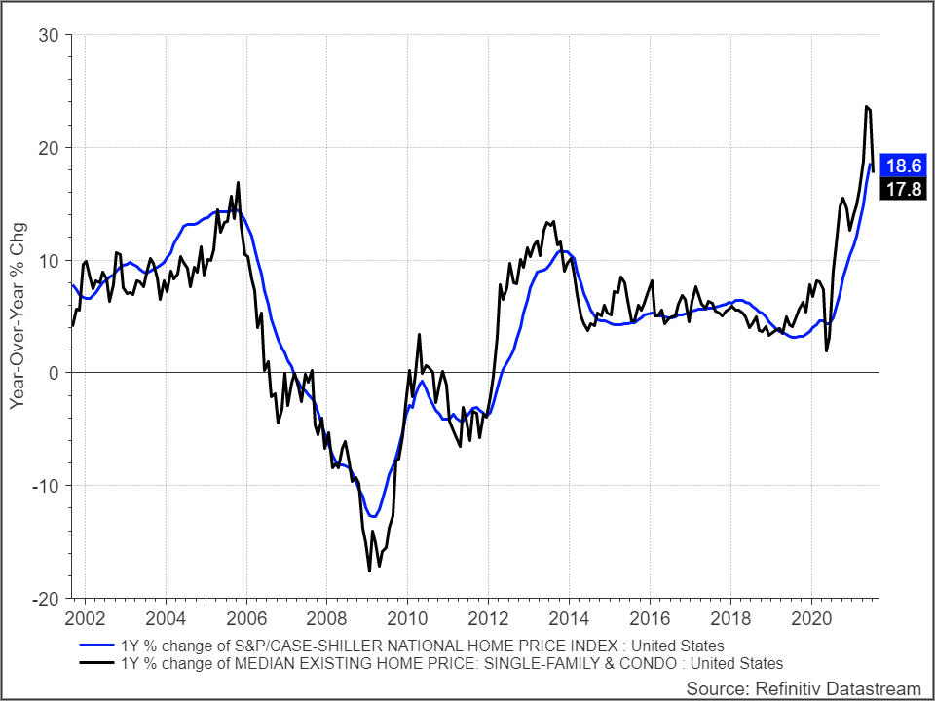
Background & Problem Statement
01
With the development of the real estate industry, all countries, societies, and individuals have become more concerned about the price of housing.
2008 financial crisis
2020 Covid-19 pandemic

Slide 6

Competitors
01
Tryolab is a famous AI pricing company in the current market.
But the disadvantages are the models Tryolab has applied are not available for retail buyers and sellers and the consultation fees are very high.

Slide 7
Objective
01
Create house price prediction tool.
Develop a model that decreases information asymmetries between individuals and real estate agents.
Maintain a healthy real estate market in the long run.

Slide 8

02
Data Exploration

Slide 9
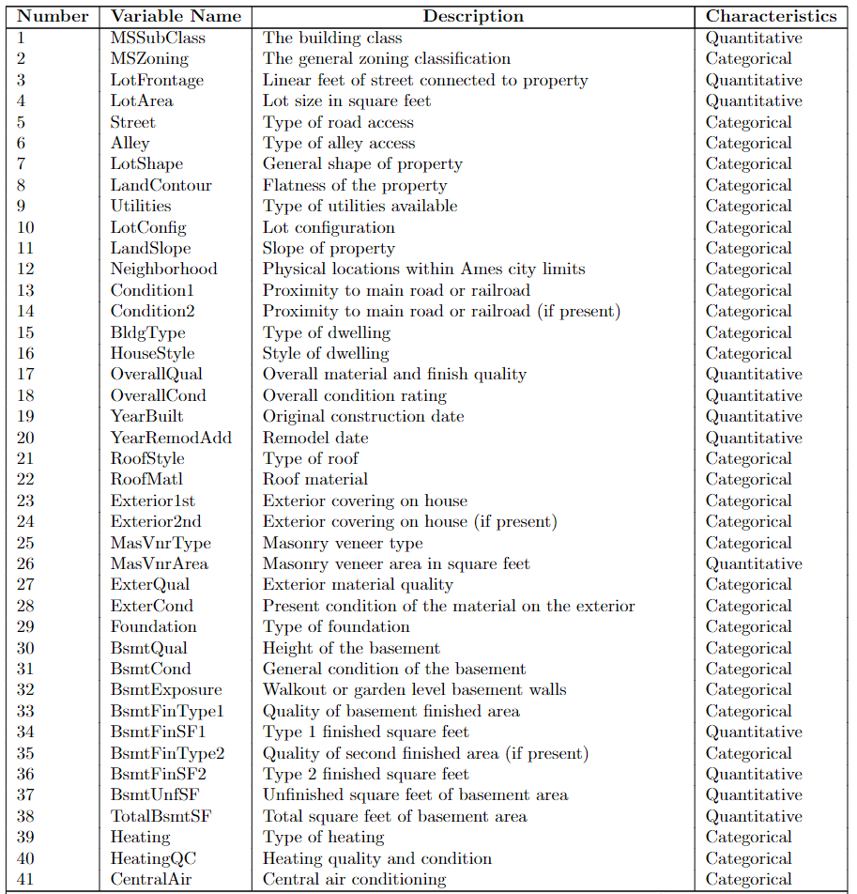
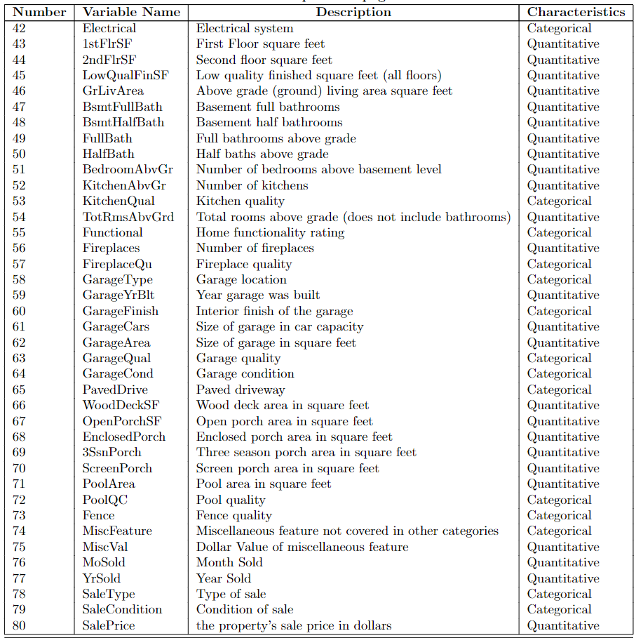
Variable Summary
02

Slide 10
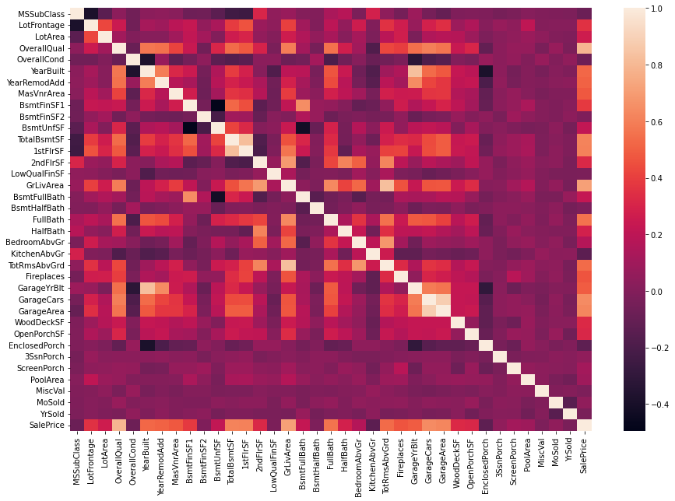
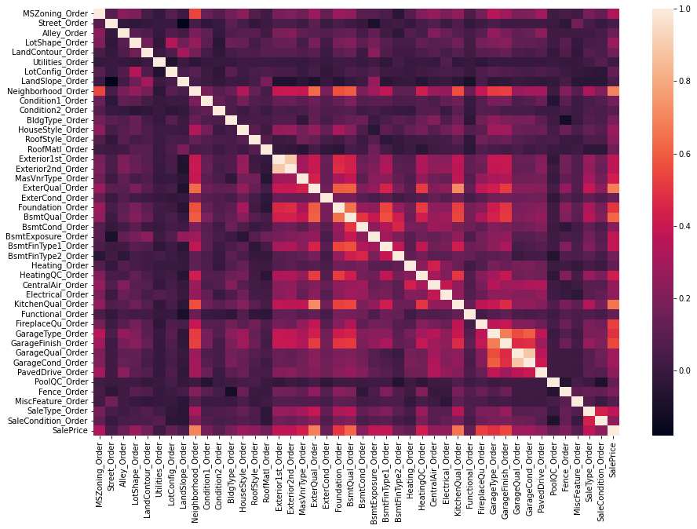
Correlation Analysis
02

Slide 11
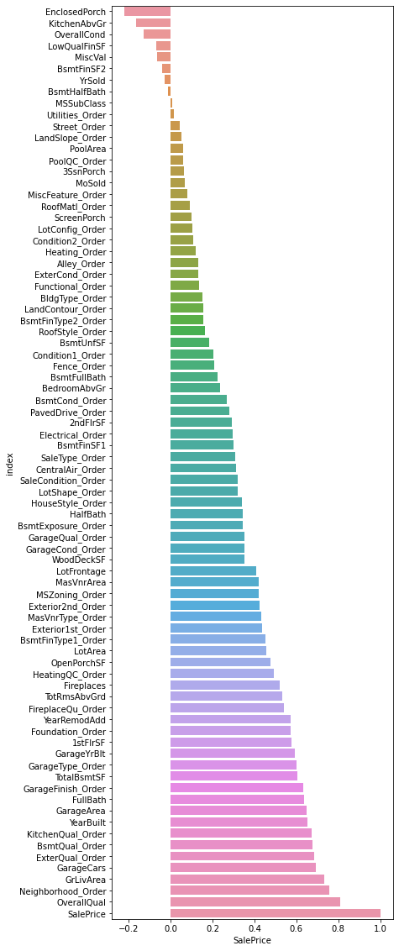
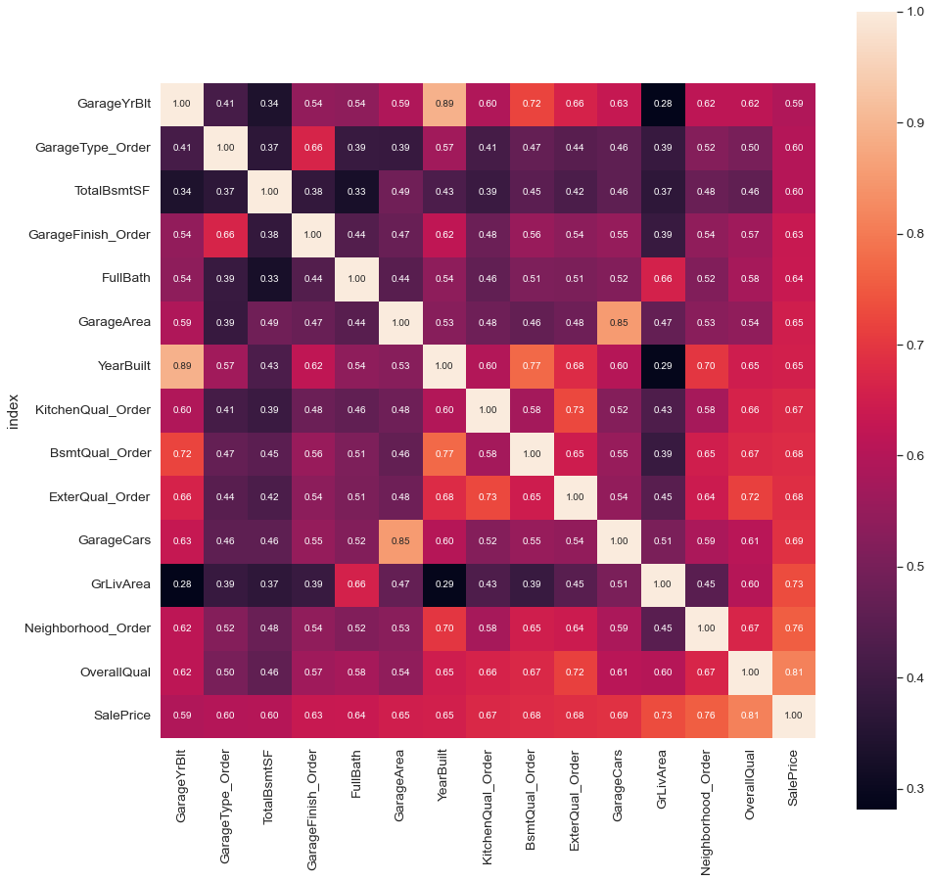
02
Correlation Analysis
Pearson correlation works with a linear relationship between two variables based on the raw data directly.
Spearman correlation works with monotonic relationships.
A clearer heat map is made for the top 15 features that have the largest influence on the sales price.

Slide 12
02
Potential Features
1. Quantitative:
GrLivArea (Above grade (ground) living area square feet)
GarageArea (Size of garage in square feet)
TotalBsmtSF (Total square feet of basement area)
2. Qualitative/Categorical:
OverallQual (Rates the overall material and finish of the house)
Neighborhood (Physical locations within Ames city limits)
YearBuilt (Original construction date)

Slide 13

03
Model Exploration & Results

Slide 14



Linear Regression & Lasso Regression
03
Given a data set of n records, linear regression assumes the there is a linear relationship between dependent variable y and p-vector independent variables x. This relationship is modeled through a random variable. Thus, the model takes the form
And the linear model can be written in matrix notation as
Linear Regression
Lasso Regression

Slide 15
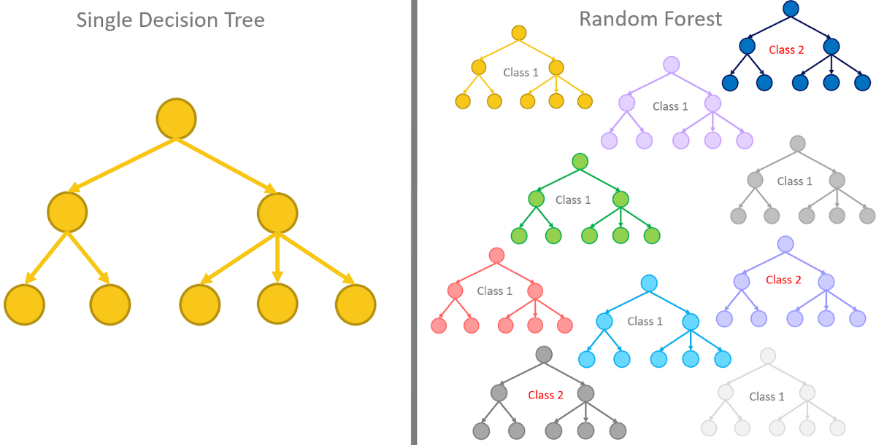
Decision Tree & Random Forest
03
Random forests is an ensemble learning method for classification and regression by constructing a multitude of decision trees.
The average forecast of each individual tree is returned for regression tasks.
Decision tree is a supervised learning algorithm, which can be used for regression topics since there is a hierarchical tree structure consisting of the root node, internal node as well as leaf node.

Slide 16
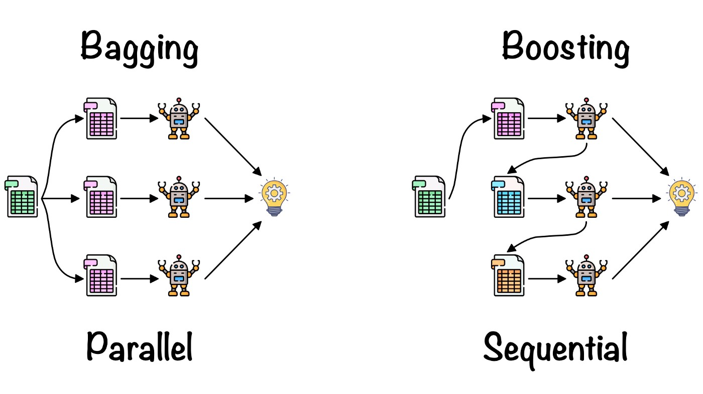
KNN & XGBoost
03
XGBoost (eXtreme Gradient Boosting) is an open-source library that provides a regularizing gradient boosting framework.
There are mainly four inputs: a training set, a differentiable loss function, a number of weak learners, and a learning rate.
KNN(K-nearest neighbors algorithm) is a non-parametric supervised learning algorithm.
Predicted value: average of the values of k nearest neighbors.

Slide 17
Stacked Model
03
The stacked regressor is a bagging method of Ensemble Learning. Some well-performed models will be combined together to generate a better result. This stacked method can also avoid the over-fitting problem since it takes the average predictions of all the effective models

Slide 18
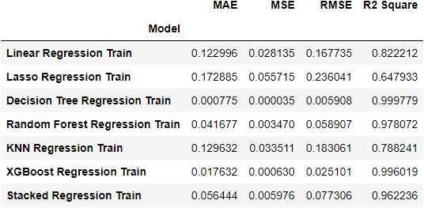
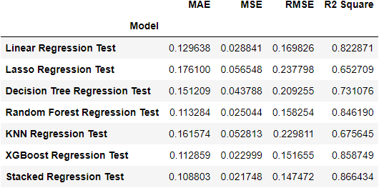
Model Results – Overall Metrics
03
There are significant overfitting problems in Decision Tree.
Linear regression is the most stable one.
Lasso regression is worse than linear regression even though it includes more punishments.

Slide 19
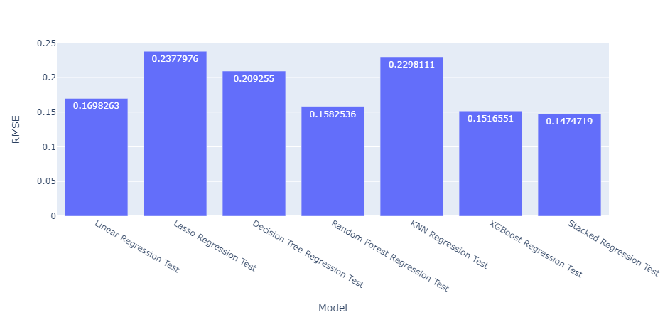
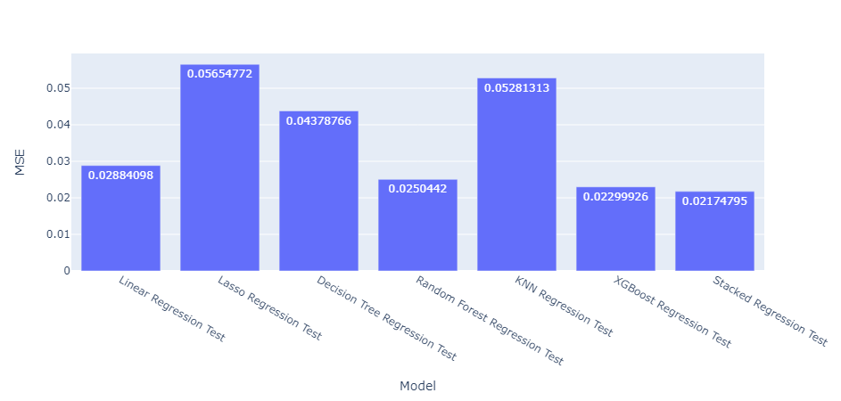
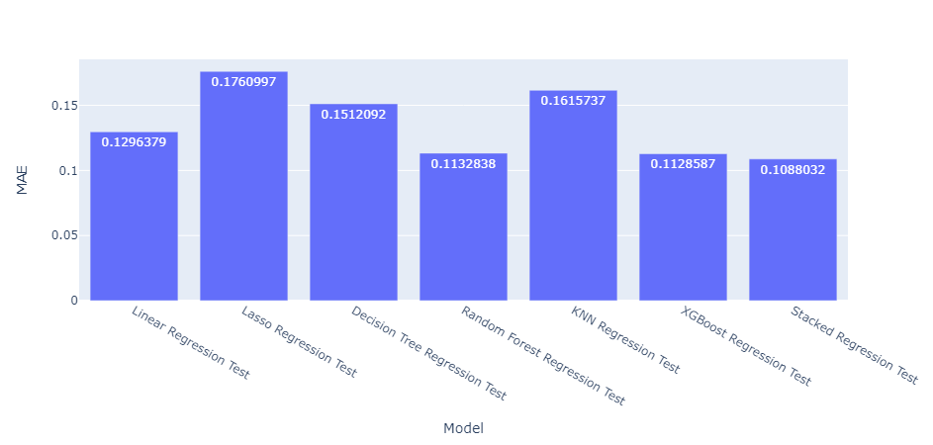
Model Results – Error Metrics
03
The stacked method outperform the other models.
In addition, lasso regression, decision tree and KNN have shown poor predicting power, which means they are not quite useful in evaluating house sale prices in the current setting.

Slide 20
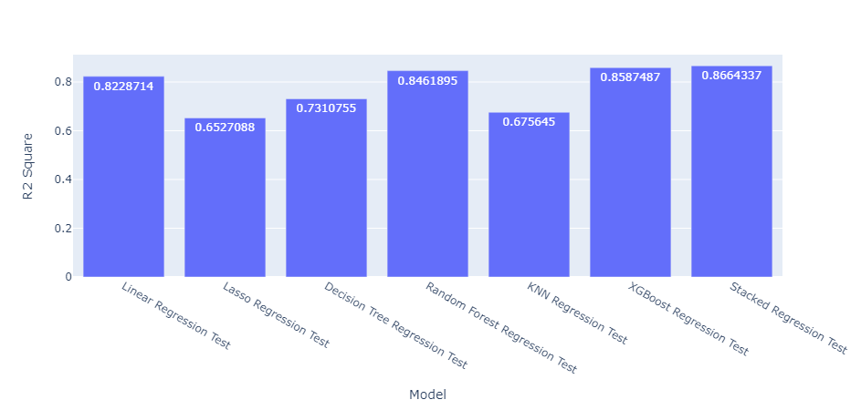
Model Results – R square
03
In terms of R2, the results align with the above error metrics that the stacked regression achieves the highest R square.
0.866 means the stacked regression explains 86.6% variance of the whole data set, which is relatively high.

Slide 21
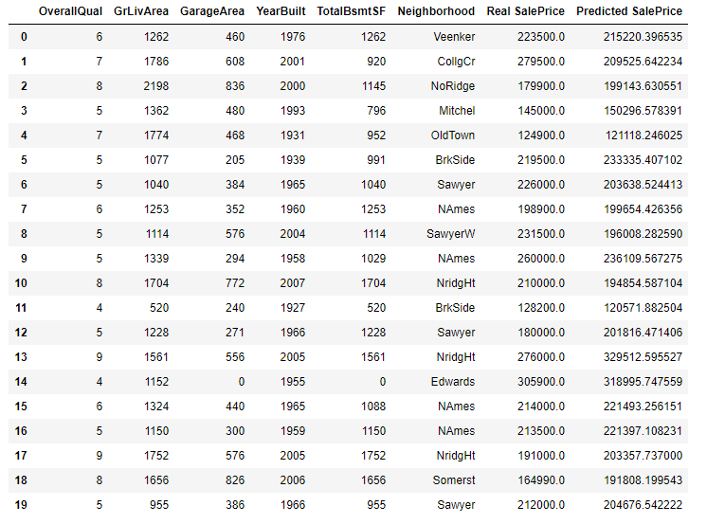
Stacked Model Results
03
The stacked model can well distinguish different features of a house and assign weights to them
Little difference between real price and predicted price

Slide 22
04
Conclusion

Slide 23
Conclusion
04
This research explores the house price-related data in Ames.
Mainstream machine learning algorithms have been used on house sale price prediction.
Measured by error metrics and R-square, the stacked model achieves the most accurate predictions.

Slide 24


